Slide 1
第十六章 组合模式
组合模式
将对象组合成数形结构以表示“部分-整体”的层次结构。Composite使得用户对单个对象和组合对象的使用具有一致性。
Composite Pattern
Compose objects into tree structures to represent part-whole hierarchies. Composite lets clients treat individual objects and compositions of objects uniformly.

Slide 2
一 、 概述
组合模式是关于怎样将对象形成树形结构来表现整体和部分的层次结构的成熟模式。使用组合模式，可以让用户以一致的方式处理个体对象和组合对象，组合模式的关键在于无论是个体对象还是组合对象都实现了相同的接口或都是同一个抽象类的子类。

Slide 3
二、组合模式的结构与使用
模式的结构中包括三种角色：
抽象组件（Component）
Composite节点（Composite Node）
Leaf节点（Leaf Node）

Slide 4
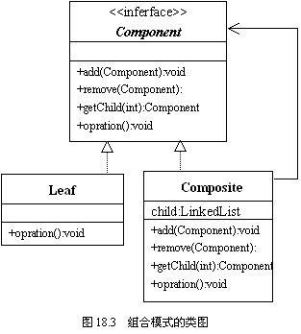
模式的UML类图

Slide 5
模式的结构的描述与使用
用组合模式描述连队的军士结构，并计算军饷。
一个连队由1个连长，2个排长，6个班长和60个士兵构成。连长直接指挥2个排长，每个排长直接指挥3个班长，每个班长直接指挥10个士兵。
连长的军饷是每月5000元，排长4000元，班长2000元，士兵1000元。
使用组合模式，让连队的军士形成树形结构，并计算一个班的军饷，一个排的军饷和整个连队的军饷。

Slide 6
1．抽象组件（Component） : MilitaryPerson.java
import java.util.*;
public interface MilitaryPerson{
public void add(MilitaryPerson person) ;
public void remove(MilitaryPerson person) ;
public MilitaryPerson getChild(int index);
public Iterator<MilitaryPerson> getAllChildren() ;
public boolean isLeaf();
public double getSalary();
public void setSalary(double salary);
}

Slide 7
2． Composite节点（Composite Node）: MilitaryOfficer.java
import java.util.*;
public class MilitaryOfficer implements MilitaryPerson{
LinkedList<MilitaryPerson> list;
String name;
double salary;
MilitaryOfficer(String name,double salary){
this.name=name;
this.salary=salary;
list=new LinkedList<MilitaryPerson>();
}
public void add(MilitaryPerson person) {
list.add(person);
}
public void remove(MilitaryPerson person){
list.remove(person);
}

Slide 8
public MilitaryPerson getChild(int index) {
return list.get(index);
}
public Iterator<MilitaryPerson> getAllChildren() {
return list.iterator();
}
public boolean isLeaf(){
return false;
}
public double getSalary(){
return salary;
}
public void setSalary(double salary){
this.salary=salary;
}
}

Slide 9
3．Leaf节点（Leaf Node）：MilitarySoldier.java
import java.util.*;
public class MilitarySoldier implements MilitaryPerson{
double salary;
String name;
MilitarySoldier(String name,double salary){
this.name=name;
this.salary=salary;
}
public void add(MilitaryPerson person) {}
public void remove (MilitaryPerson person){}

Slide 10
public MilitaryPerson getChild(int index) {
return null;
}
public Iterator<MilitaryPerson> getAllChildren() {
return null;
}
public boolean isLeaf(){
return true;
}
public double getSalary(){
return salary;
}
public void setSalary(double salary){
this.salary=salary;
}
}

Slide 11
4．应用_1:ComputerSalary.java
import java.util.*;
public class ComputerSalary{
public static double computerSalary(MilitaryPerson person){
double sum=0;
if(person.isLeaf()==true){
sum=sum+person.getSalary();
}

Slide 12
if(person.isLeaf()==false){
sum=sum+person.getSalary();
Iterator<MilitaryPerson> iterator=person.getAllChildren();
while(iterator.hasNext()){
MilitaryPerson p= iterator.next();
sum=sum+computerSalary(p);;
}
}
return sum;
}
}

Slide 13
4．应用_2: Application.java
public class Application{
public static void main(String args[]) {
MilitaryPerson 连长=new MilitaryOfficer("连长",5000);
MilitaryPerson 排长1=new MilitaryOfficer("一排长",4000);
MilitaryPerson 排长2=new MilitaryOfficer("二排长",4000);
MilitaryPerson 班长11=new MilitaryOfficer("一班长",2000);
MilitaryPerson 班长12=new MilitaryOfficer("二班长",2000);
MilitaryPerson 班长13=new MilitaryOfficer("三班长",2000);
MilitaryPerson 班长21=new MilitaryOfficer("一班长",2000);
MilitaryPerson 班长22=new MilitaryOfficer("二班长",2000);
MilitaryPerson 班长23=new MilitaryOfficer("三班长",2000);
MilitaryPerson []士兵=new MilitarySoldier[60];
for(int i=0;i<士兵.length;i++){
士兵[i]=new MilitarySoldier("小兵",1000);
}

Slide 14
连长.add(排长1); 连长.add(排长2);
排长1.add(班长11); 排长1.add(班长12);
排长1.add(班长13); 排长2.add(班长21);
排长2.add(班长22); 排长2.add(班长23);
for(int i=0;i<=9;i++){
班长11.add(士兵[i]); 班长12.add(士兵[i+10]);
班长13.add(士兵[i+20]); 班长21.add(士兵[i+30]);
班长22.add(士兵[i+40]); 班长23.add(士兵[i+50]);
}
System.out.println("一排的军饷:"+
ComputerSalary.computerSalary(排长1));
System.out.println("一班的军饷:"+ ComputerSalary.computerSalary(班长11));
System.out.println("全连的军饷:"+
ComputerSalary.computerSalary(连长));
}
}

Slide 15
三、组合模式的优点
组合模式中包含有个体对象和组合对象，并形成树形结构，使用户可以方便地处理个体对象和组合对象。
组合对象和个体对象实现了相同的接口，用户一般不需区分个体对象和组合对象。
当增加新的Composite节点和Leaf节点时，用户的重要代码不需要作出修改。

Slide 16
四、其它应用示例
应用例：表示图形元素的结构
Graphic
Draw()
Add(Graphic)
Remove(Graphic)
GetChild(int)
*
graphics
Line
Draw()
Rectangle
Draw()
Text
Draw()
Picture
Draw()
Add(Graphic)
Remove(Graphic)
GetChild(int)
forall g in graphics
g.Draw()
add g to list of graphics

Slide 17
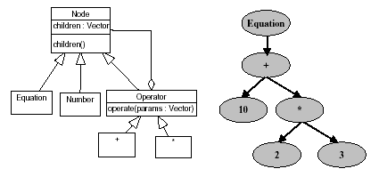
应用例：算数式、正则表达式,SQL内部结构等；

Slide 18
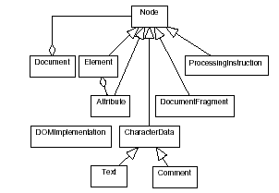
应用例：文档对象模型 ：W3C的XML处理规范

Slide 19
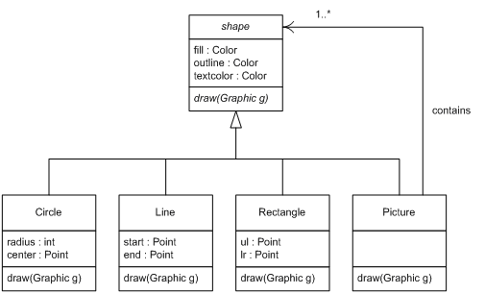

Slide 20
import java.applet.*;
import java.awt.*;
public class Composite extends Applet {
Picture pict = new Picture();
public void init() {
pict.add(new Circle(new Point(10,10),50));
pict.add(new Rectangle(10,80,60,140));
pict.add(new Line(10,150,60, 170));
pict.add(new Circle(new Point(100,80),20));
}
public void paint(Graphics g) {
pict.draw(g);
}
}

Slide 21
import java.awt.*;
public abstract class shape extends Object {
Color fill, outline, textcolor; // The various colors we use
public shape() {
fill = new Color(200, 200, 200); // Equal red, green, and blue == gray
outline = Color.blue; // Same as new Color(0, 0, 255)
textcolor = Color.red; // Same as new Color(255, 0, 0)
}
public void setFillColor(Color c) { fill = c; }
public void setOutlineColor(Color c) { outline = c; }
public void setTextColor(Color c) { textcolor = c; }
public abstract void draw(Graphics g);
}

Slide 22
import java.awt.*;
import java.util.*;
public class Picture extends shape { // ISA relationship
Vector list = new Vector(); // HASA relationship
public void add(shape s) {
list.addElement(s);
}
public void draw(Graphics g) {
Iterator it = list.iterator();
while (it.hasNext()){
it.next().draw(g);
}
}
}

Slide 23
import java.awt.*;
public class Circle extends shape {
int radius;
Point center;
public Circle(Point c,int r) {
center = c;
radius = r;
}
public void draw(Graphics g) {
g.setColor(fill);
g.fillOval(center.x, center.y, radius, radius);
g.setColor(outline);
g.drawOval(center.x, center.y, radius, radius);
}
}

Slide 24
import java.awt.*;
public class Line extends shape {
Point start,end;
public Line(int sx,int sy,int ex,int ey) {
start = new Point(sx,sy);
end = new Point(ex,ey);
}
public void draw(Graphics g) {
g.setColor(outline);
g.drawLine(start.x,start.y,end.x,end.y);
}
}

Slide 25
import java.awt.*;
public class Rectangle extends shape {
Point ul,lr;
public Rectangle(Point u,Point l) {
ul = u;
lr = l; }
public Rectangle(int x1,int y1,int x2, int y2) {
ul = new Point(x1,y1);
lr = new Point(x2,y2); }
public void draw(Graphics g) {
g.setColor(fill);
g.fillRect(ul.x, ul.y, lr.x - ul.x, lr.y - ul.y);
g.setColor(outline);
g.drawRect(ul.x, ul.y, lr.x - ul.x, lr.y - ul.y); }
}

Slide 26
public class Point {
public int x;
public int y;
public Point() {
x = y = 0;
}
public Point(Point p) {
x = p.x;
y = p.y;
}
public Point(int i,int j) {
x = i;
y = j;
}
}

Slide 27
DOM(Document Object Model)
DOM的基本对象有5个：Document，Node，NodeList，Element和Attr
Document对象代表了整个XML的文档，所有其它的Node，都以一定的顺序包含在Document对象之内，排列成一个树形的结构，程序员可以通过遍历这颗树来得到XML文档的所有的内容，这也是对XML文档操作的起点。我们总是先通过解析XML源文件而得到一个Document对象，然后再来执行后续的操作。此外，Document还包含了创建其它节点的方法，比如createAttribut()用来创建一个Attr对象。

Slide 28
<?xml version="1.0" standalone="yes"?>
<links>
<link>
<text>JSP Insider</text>
<url newWindow="no">http://www.jspinsider.com</url>
<author>JSP Insider</author>
<date>
<day>2</day>
<month>1</month>
<year>2001</year>
</date>
<description>A JSP information site.</description>
</link>
<link>
<text>The makers of Java</text>
<url newWindow="no">http://java.sun.com</url>
<author>Sun Microsystems</author>
<date>
<day>3</day>
<month>1</month>
<year>2001</year>
</date>
<description>Sun Microsystem's website.</description>
</link>
</links>

Slide 29
import javax.xml.parsers.*;
import org.w3c.dom.*;
DocumentBuilderFactory factory = DocumentBuilderFactory.newInstance();
DocumentBuilder builder=factory.newDocumentBuilder();
Document doc=builder.parse("links.xml");
doc.normalize();

Slide 30
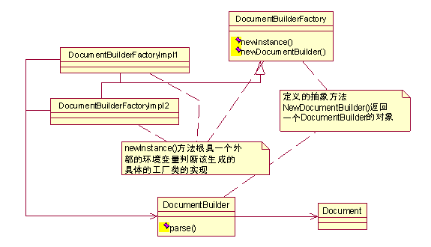

Slide 31
NodeList links =doc.getElementsByTagName("link");

Slide 32
for (int i=0;i<links.getLength();i++){
Element link=(Element) links.item(i);
System.out.print("Content: ");
System.out.println(link.getElementsByTagName("text").item(0).getFirstChild().getNodeValue());
System.out.print("URL: ");
System.out.println(link.getElementsByTagName("url").item(0).getFirstChild().getNodeValue());
}

Slide 33
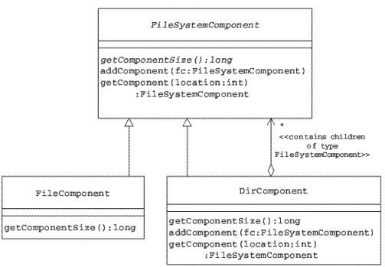
文件系统

Slide 34
public abstract class FileSystemComponent {
String name;
public FileSystemComponent(String cName) {
name = cName;
}
public void addComponent(FileSystemComponent component) { }
public FileSystemComponent getComponent(int componentNum) { }
public abstract long getComponentSize();
}

Slide 35
public class FileComponent extends FileSystemComponent {
private long size;
public FileComponent(String cName, long sz) {
super(cName);
size = sz;
}
public long getComponentSize() {
return size;
}
}

Slide 36
public class DirComponent extends FileSystemComponent {
Vector dirContents = new Vector();
public DirComponent(String cName) {
super(cName);
}
public void addComponent(FileSystemComponent fc) throws CompositeException {
dirContents.add(fc);
}

Slide 37
public FileSystemComponent getComponent(int location) throws CompositeException {
return (FileSystemComponent) dirContents.elementAt(location);
}
public long getComponentSize() {
long sizeOfAllFiles = 0;
Enumeration e = dirContents.elements();
while (e.hasMoreElements()) {
FileSystemComponent component = (FileSystemComponent) e.nextElement();
sizeOfAllFiles = sizeOfAllFiles + (component.getComponentSize());
}
return sizeOfAllFiles;
}
}

Slide 38
public class CompositeDemo {
public static final String SEPARATOR = ", ";
public static void main(String[] args) {
FileSystemComponent mainFolder = new DirComponent("Year2000");
FileSystemComponent subFolder1 = new DirComponent("Jan");
FileSystemComponent subFolder2 = new DirComponent("Feb");
FileSystemComponent folder1File1 = new FileComponent("Jan1DataFile.txt",1000);
FileSystemComponent folder2File1 = new FileComponent("Feb1DataFile.txt",3000);

Slide 39
try {
mainFolder.addComponent(subFolder1);
mainFolder.addComponent(subFolder2);
subFolder1.addComponent(folder1File1);
subFolder2.addComponent(folder2File1);
} catch (CompositeException ex) { }

Slide 40
System.out.println(" Main Folder Size= " + mainFolder.getComponentSize() + "kb");
System.out.println(" Sub Folder1 Size= " + subFolder1.getComponentSize() + "kb");
System.out.println(" File1 in Folder1 size= " + folder1File1.getComponentSize() + "kb");
}
}

